Slide 1

Library management system
- Aditya Singh

Slide 2
Introduction
Library management is a project that manages and stores books information electronically according to students needs. The system helps both students and library manager to keep a constant track of all the books available in the library. It allows both the admin and the student to search for the desired book.
The project titled Library Management System is Library Management software for monitoring and controlling the transactions in a library. The project “Library Management System” is developed in C, which mainly focuses on basic operations in a library like adding new books, and updating new information, searching books and members and return books.
This project “LIBRARY MANAGEMENT SYSTEM” gives us the complete information about the library. We can enter the record of new books and retrieve the details of books available in the library. We can issue the books to the students and maintain their records and can also check how many books are issued and stock available in the library. In this project we can maintain the late fine of students who returns the issued books after the due date

Slide 3
Project Abstract
1. Library Management System is a simple system application without graphics developed using C programming language.
2. It is compiled in Dev C++ and using GCC compiler.
3. This mini project utilizes various aspects of the C language such as functions, arrays, pointers, file handling and data structure.
4. With this simple application , users can perform all the book related operations and features provided by todays advanced library management software.
5. With this library management system we can store book information with author , number of pages , price and count the number of books and perform various updates with the list.

Slide 4
Project Features
To add book name
To add authors name
To add number of pages
To add the price of the book
To view total no of books
To display book information
At last to close the program exit feature is given

Slide 5
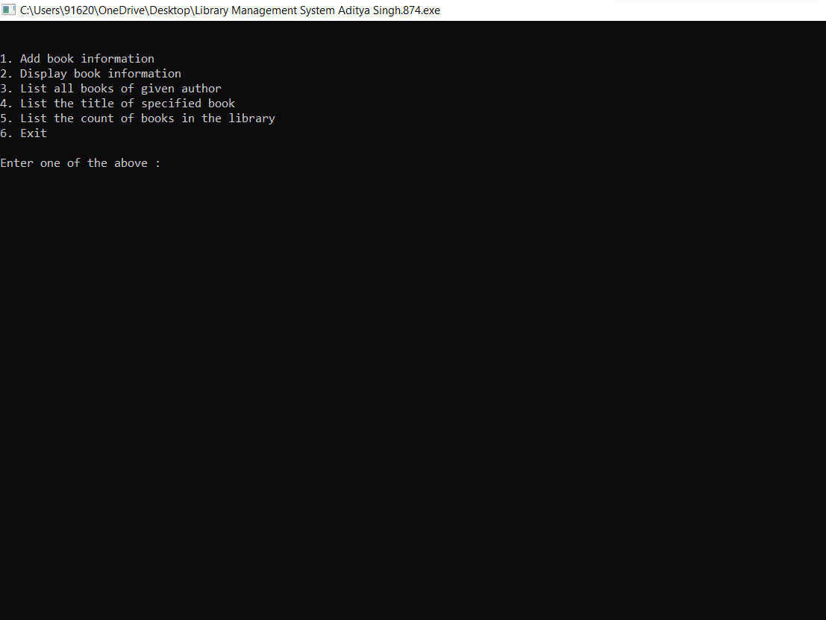
Library management program execution

Slide 6
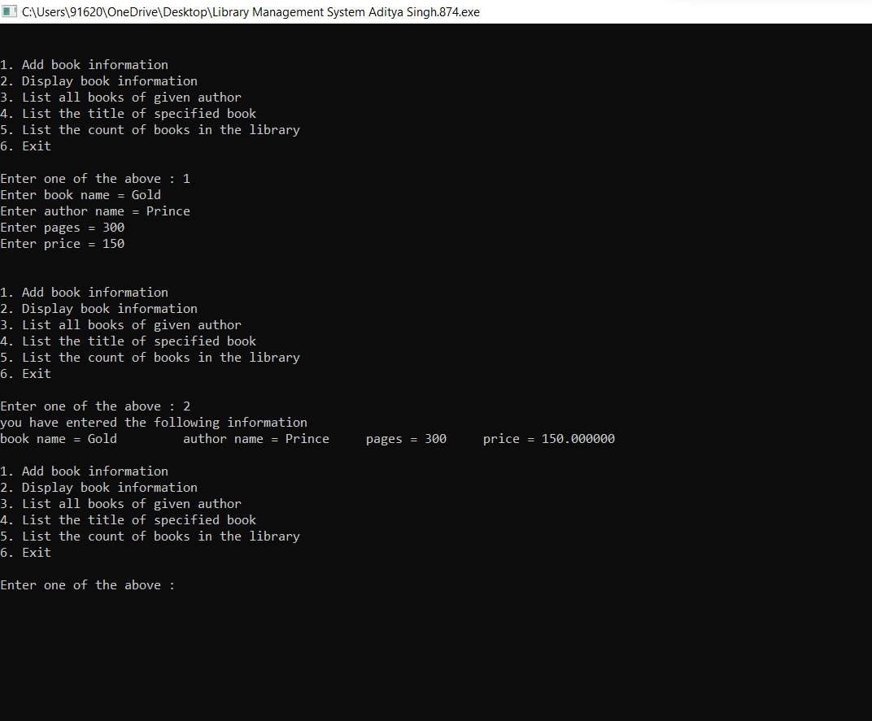
Saving Book Information

Slide 7
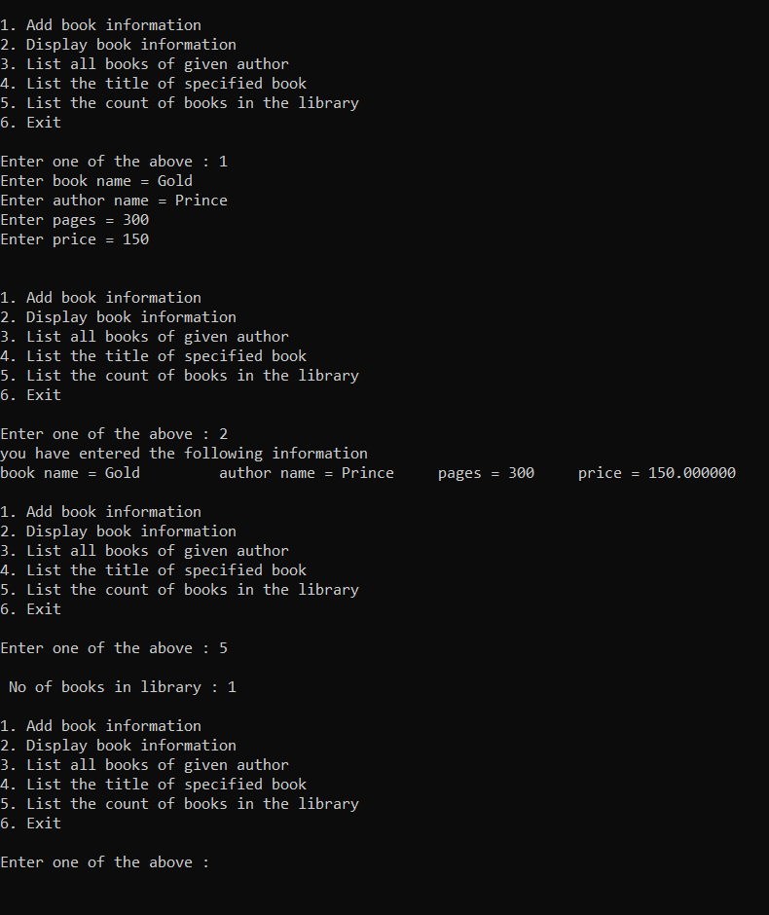
Total Books Saved Count

Slide 8
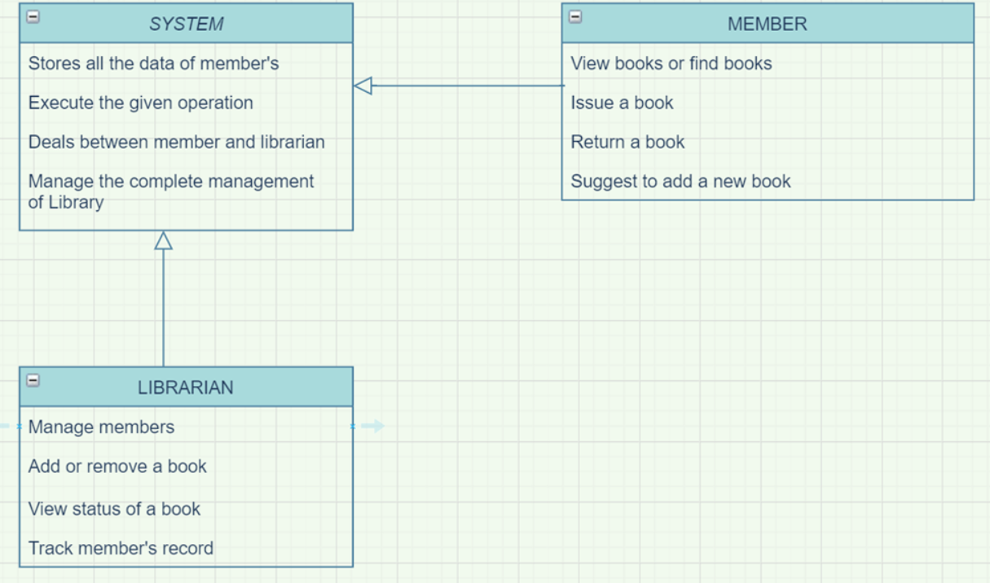
Flow chart for Library management system

Slide 9
BENEFITS:
a) Record Maintenance.
b) Web-Based Solution.
c) Saves Time and Cost.
d) Secure and Reliable.
e) Increases Efficiency.
f) Simple and Easy to Use.

Slide 10
Thank You …….
Project made by
Aditya Singh
RA2111003011874

